Slide 1
ZOMATO PROJECT
FINAL PROJECT DONE BY :-1)Mr.Sefton J Britto 2)Miss.Akansha Pravin Pawar 3)Mr.Mohit Arun Nachavankar 4)Ms.Somya
5)Mr.Nishant Naresh Gite 6)Syeed Labeeb
7)Mrs.Ashwini Sagar Vetal

Slide 2

ABOUT THE DATASET
(1) This data is all about the Zomato restaurants Customers with the feedback on the cost , Votes and other 23 fields to describe the data.
(2) The most popular field used in this is
* COUNTRY
* CITY
* RESTAURANT NAME
* AVERAGE COST OF TWO
* VOTED BY CUSTOMERS

Slide 3

PROBLEMS AND ANALYSIS
In the data provide we need to identify the low or under rated restaurants and need to update the restaurants.
Find out the cheapest restaurant belong to the city and its country similarly the most expensive restaurant belong to the city and country.
The distribution of restaurant over the various countries such as India , USA ,UAE and few other countries.

Slide 4

Tools used for this graph
** Tools used for this analyses is Tableau .
Reason for using Tableau is ,
(1) Most powerful tool for data visualization .
(2) More compatible with various types of database such as excel , SQL , JSON and few other datatypes .
(3) Superb easily interactive and friendly tool for visualization .

Slide 5
RESULTS
* City With Cheapest Restaurant in India and USA .
* City With Expensive Restaurant in India and USA .
* A Count Of Restaurant With Rating .
* A Restaurant By Cuisines .
* Restaurant Open Financial Quarter wise.
* Country With Count Of Restaurant .
* City With Count Of Restaurant .

Slide 6
ZOMATO
SALES
ANALYSIS
TOTAL RESTAURANT
9,551
TOTAL COUNTRY
15
VOTING
1.50M
TOTAL CITY
141
TOTAL SALES USD
96.41K ($)
TOTAL SALES (RS)
8.03M (RS)
TOTAL CUISINES
1,825

Slide 7
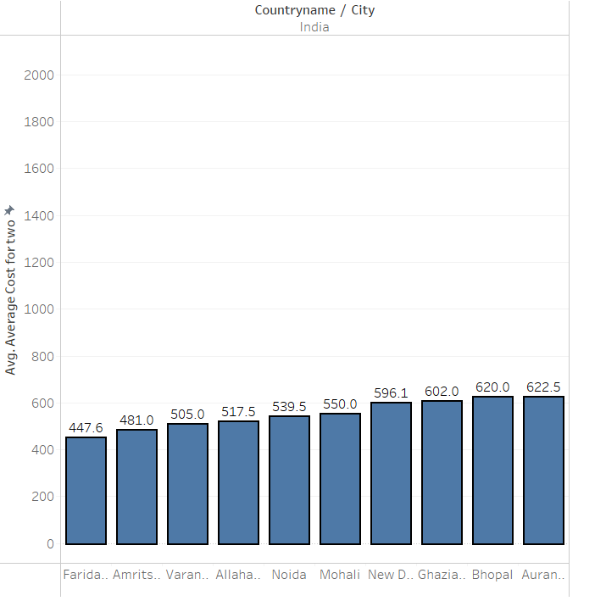
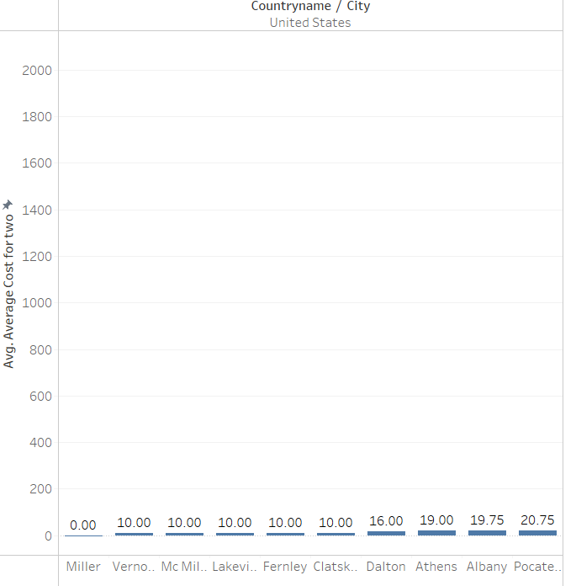
City with cheapest RESTAURANT IN INDIA AND United state
Cheapest Restaurant Cities in India
Cheapest Restaurant Cities in United State

Slide 8
Conclusion from cheapest restaurant city of india and united state
In India we found the cheapest restaurant in city Faridabad with average cost for two is 447.6 .
Similarly in United State we found the cheapest restaurant in city Miller with average cost for two is 0 (Null).

Slide 9
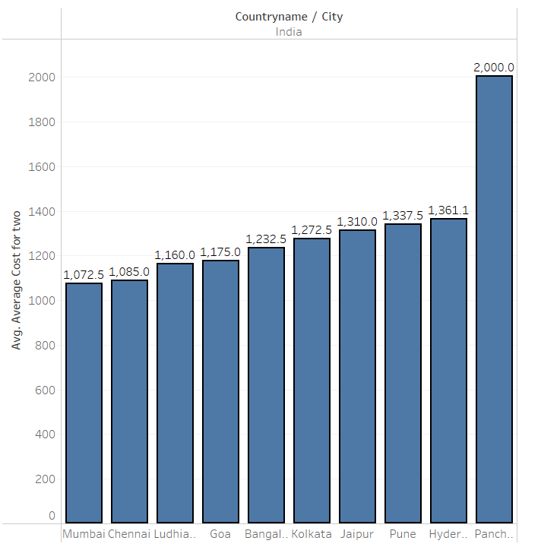
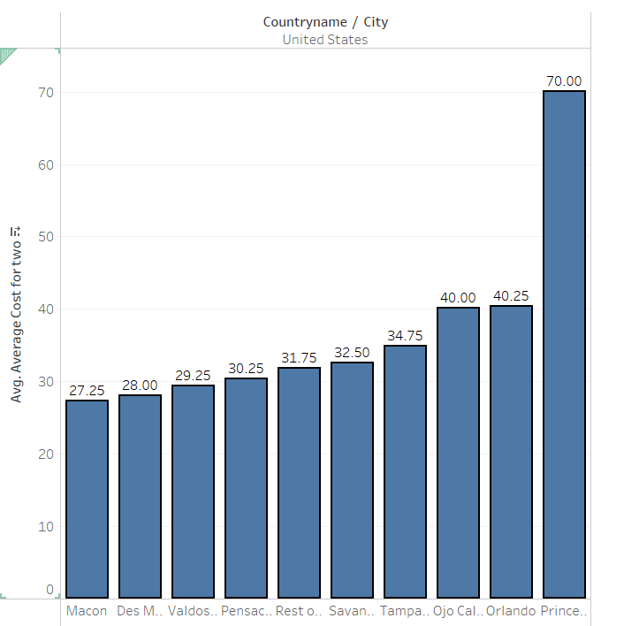
CITY WITH EXPENSIVE RESTAURANT INDIA AND UNITED STATE
Expensive Restaurant cities in India
Expensive Restaurant Cities in united state

Slide 10
Conclusion from expensive restaurant city of india and united state
In India Panchkula Followed By Hyderabad Are Most Expensive Cities with Has Higher Food Rate i.e.2000 and 1361 Respectively . So these Cities has highly Expensive Restaurant.
In United State we Found that Princeton is Most Expensive City with Restaurant that have an Average of 70 $ for two Persons in the Zomato’s data bases. The Restaurant in United State city Princeton is Heavy Cost Of Foods .

Slide 11
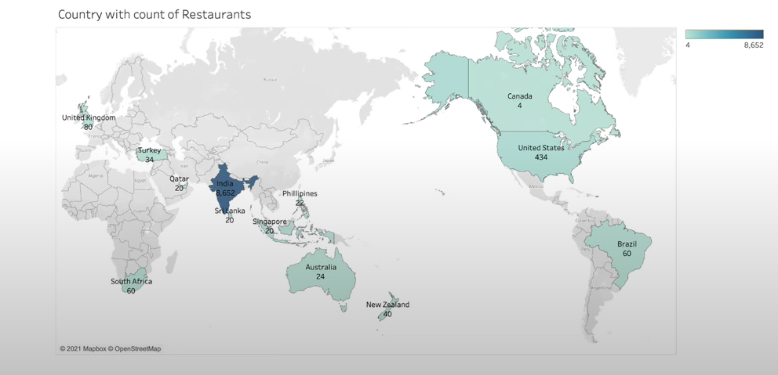
COUNTRY WITH COUNT OF RESTAURANTS

Slide 12
CONCLUSION FROM COUNT OF RESTAURANT WITH COUNTRY
In The Above We Have Different Countries With Count Of The Restaurant In Our Zomato Data Base Here .
We Found That India With Largest Population Has Large Number Of Restaurant in it i.e., 8652 Restaurants .
Then Comes The Next Is United State With 434 Restaurant and Finally Third Country is United Kingdom With 80 Restaurants . f

Slide 13
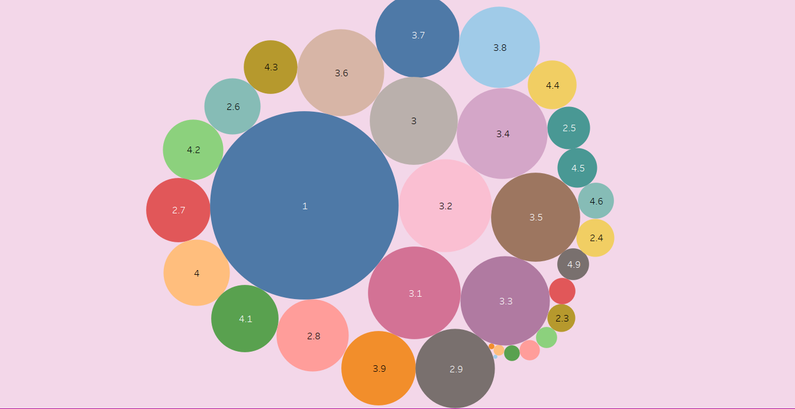
Count of restaurant with rating

Slide 14
CONCLUSION FROM Count of restaurant with rating
This Is The Most Important Graph That Contains The Rating of Restaurant Around The Global .
Here We Can See Lowest Rating is one (1) and Highest Rating is (4.9) . Most Of Restaurant Have Only (1) Rating .

Slide 15

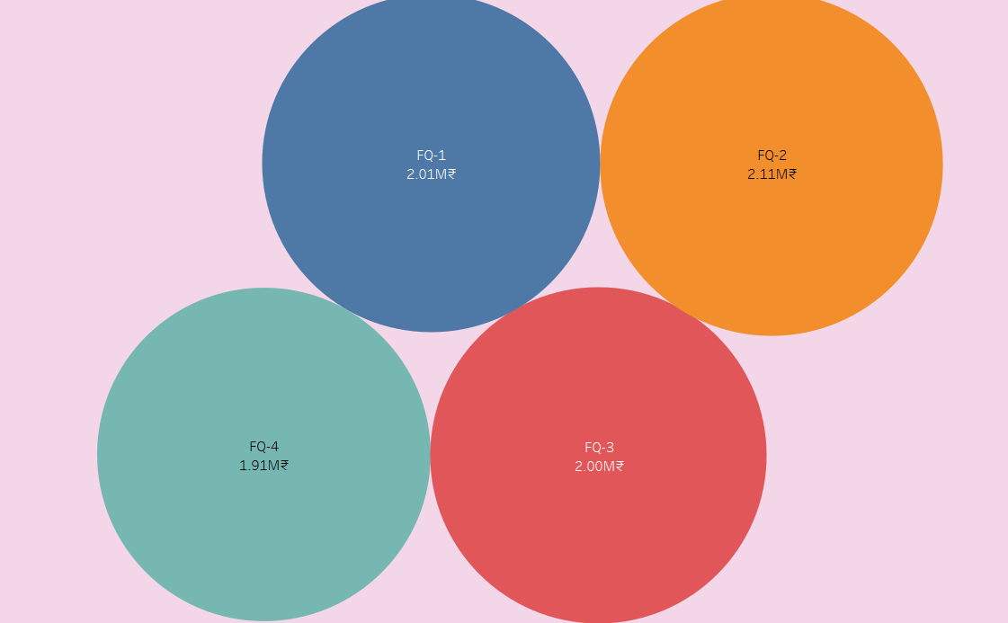
Financial quarter wise restaurant open

Slide 16
Conclusion from financial quarter wise restaurant open
In That Graph There Are Four Quarters FQ-1, FQ-2, FQ-3 and FQ-4 .In Financial Quarter FQ-1 Count Of Restaurant Id is 2393 , FQ-2 Count Of Restaurant Id is 2460 , FQ-3 Count Of Restaurant Id is 2369 and FQ-4 Have Count Of Restaurant Id is 2329.
Here We Can See That Financial Quarter (FQ-2) Has Large Number Of Restaurant Open From Other Three Quarters .

Slide 17
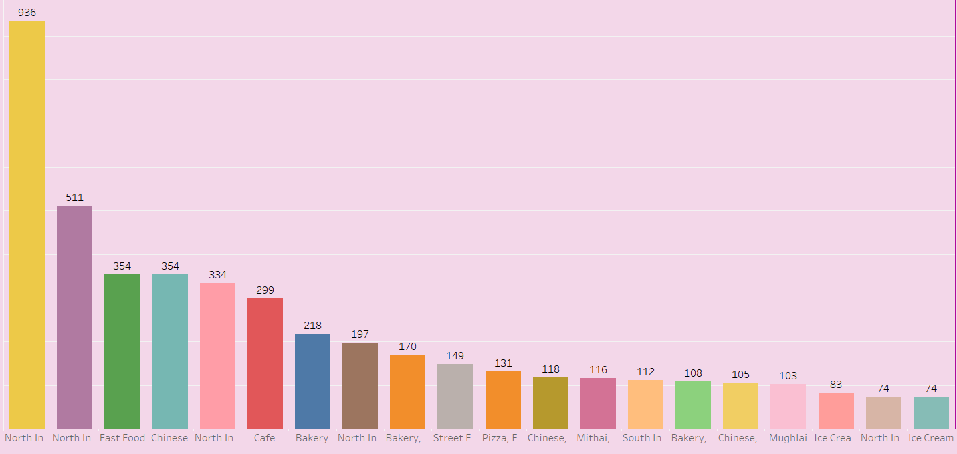
Total Restaurant by cuisines

Slide 18
Conclusion from total restaurant by cuisines
In That Graph Shows Cuisines North Indian Have Most Higher Graph Than Any Other Cuisines and Ice-Cream is Lowest Graph From Any Other Cuisines .
The Cuisines North Indian Is Most Popular Than Any Other Cuisines . Day By Day Chinese Cuisines is Also Growing Very Fastly .

Slide 19
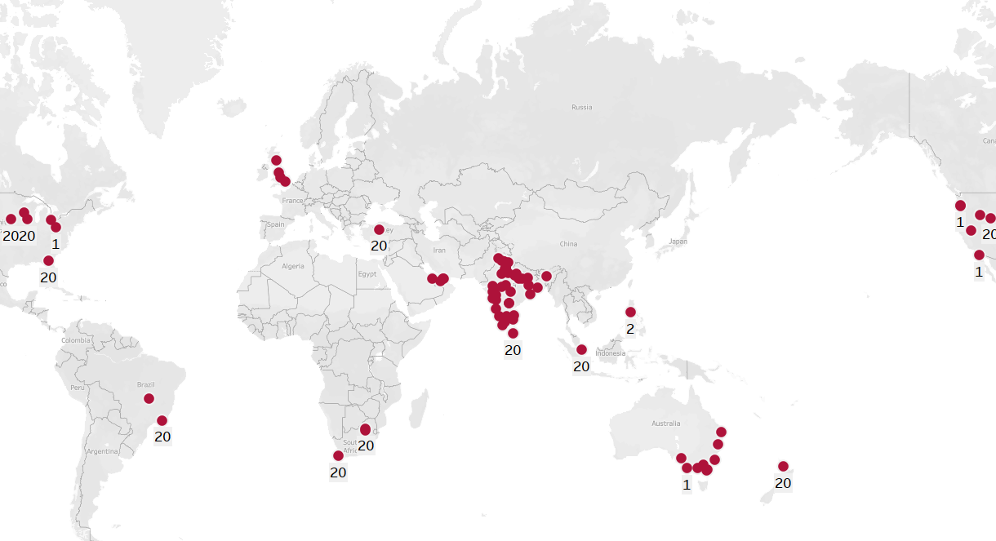
CITY WISE COUNT OF RESTAURANT

Slide 20
CONCLUSION FROM CITY WISE COUNT OF RESTAURANT
We Have Different City With Count Of The Restaurant In Our Zomato Data Base Here .
We Found That India Have Most Of Cities have Restaurants .

Slide 21


